Slide 1
C10M: radical parsers
by Robert David Graham
@ErrataRob
http://c10m.robertgraham.com/

Slide 2
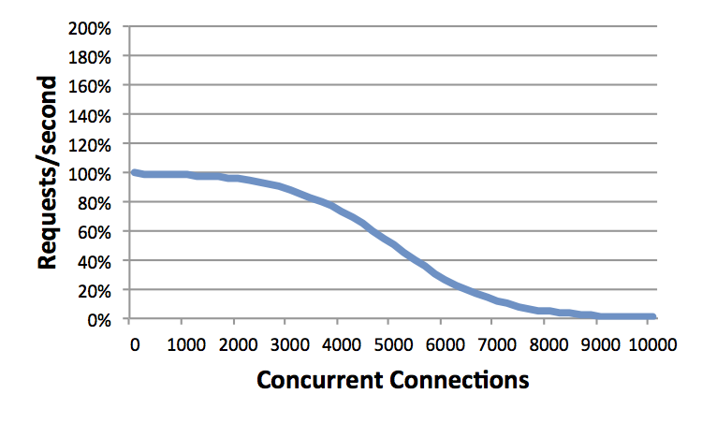
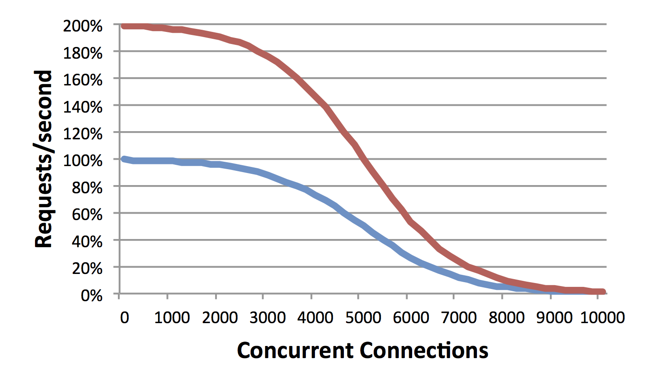
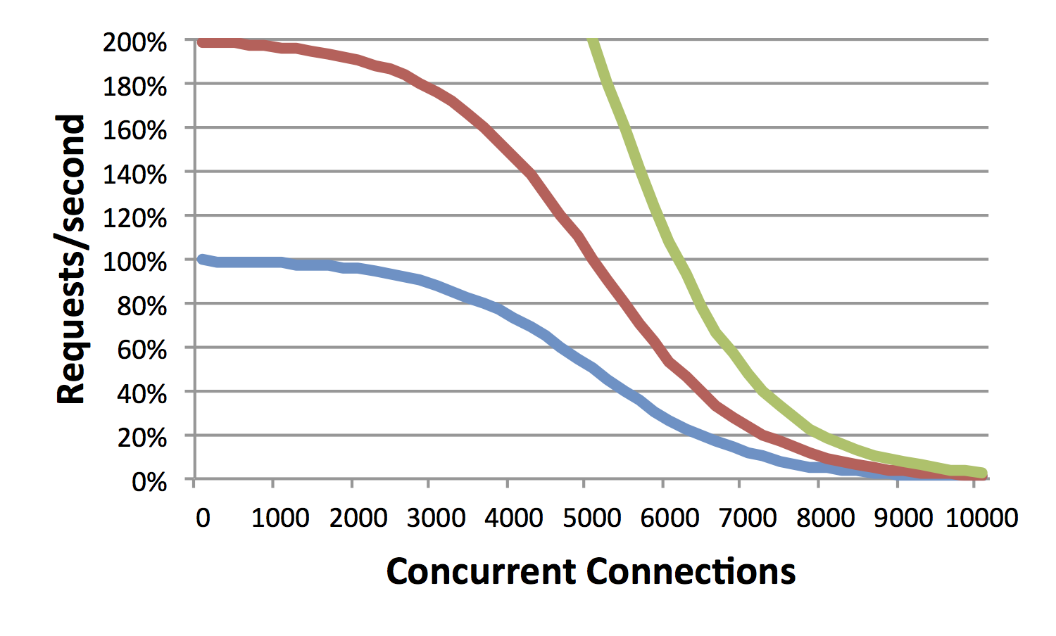
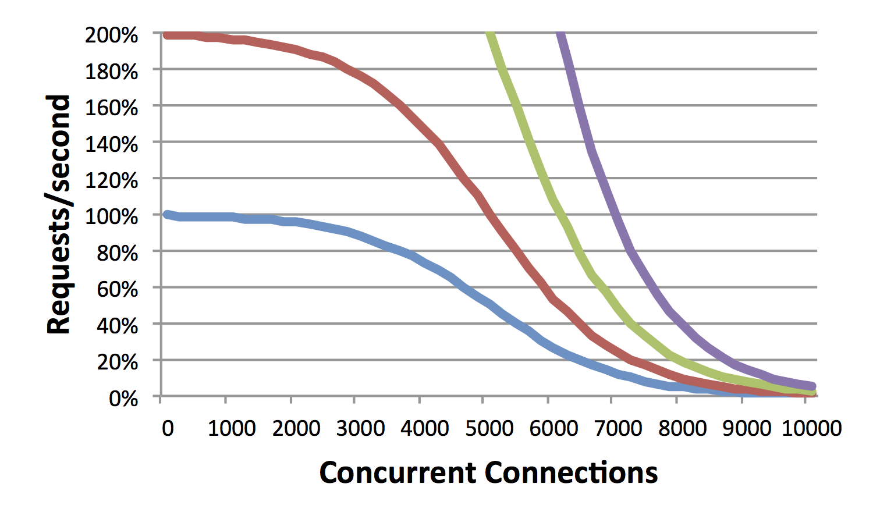
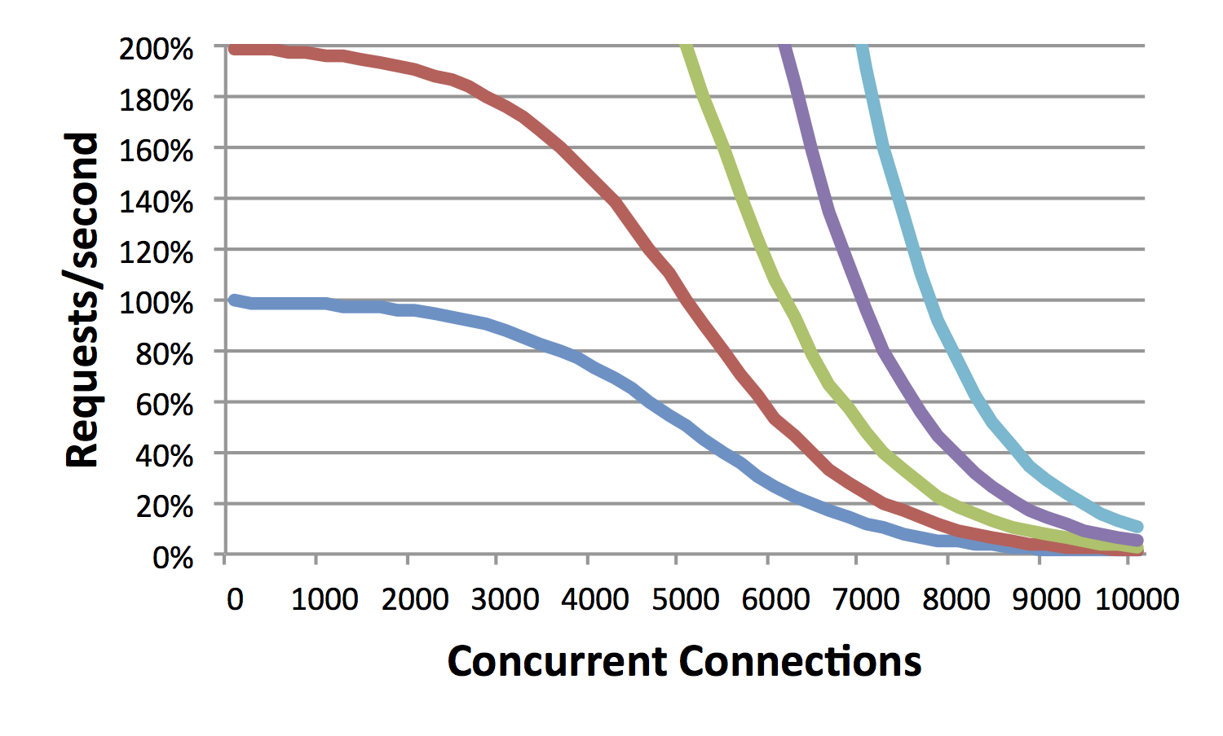
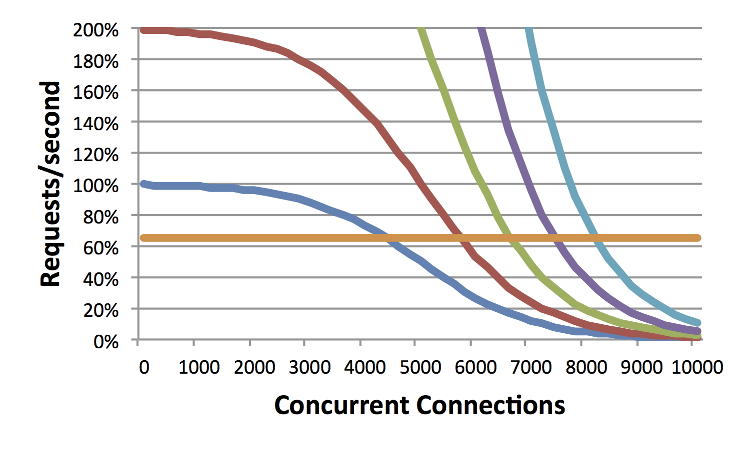
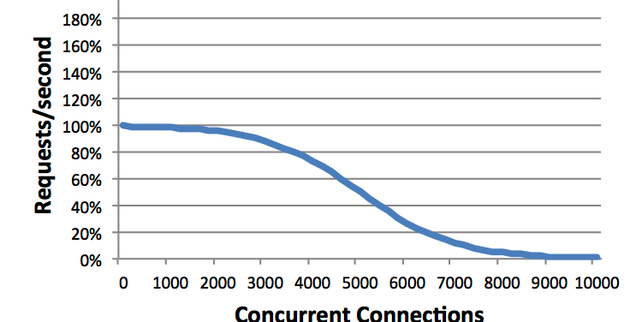
Performance
Scalability
Notes:
[THIS PAGE IS HEAVY ON ANIMATIONS. WATCH THE ANIMATIONS FIRST BEFROE READING THE TEXT]
This talk is about “scalability”, specifically, “Internet scale”. What is “scalability”?
This graph shows a well-known problem with Apache. Normally, we measure performance in “requests per second”. But there is another axis to performance: simultaneous (or “concurrent”) connections. Consider a server that handles 1000 requests per second, and that the server closes the connection immediately after serving the response. If it takes 2 seconds to handle a request, that means there will be 2,000 connections open at any point in time. Likewise, if it takes 10 seconds to handle a connection, then at 1-thousand requests per second, there will be 10,000 concurrent connections on average at any point in time. The problem with Apache is that while it can handle a few thousand open connections, it has trouble with 10,000 open connections. The more concurrent connections, the slower the web server.
Let’s say the server is performing adequately up to 5000 concurrent connections, but we want to handle 10000 concurrent connections. If we upgrade the hardware and double the speed, will that work? The second graph shows this. While we’ve indeed doubled the number of “requests-per-second”, we haven’t doubled “concurrent connections”. W/hereas it handled 5000 before, now it only handles 6000.
The same thing happens when we increase the hardware to be 4x as fast, or 8x as fast, or 16x as fast. At 16 times the speed, we still haven’t reached our target of 10,000 concurrent connections.
What I’m trying to show here is how “performance” and “scalability” are orthogonal to each other. In the rest of this talk you may be confused into thinking that I’m talking about performance, trying to make a computer run faster. I’m not. What I’m talking about is scalability.
This graph reflects the performance of Apache. Let’s instead consider a different web server called “nginx”. Nginx doesn’t reach its scalability limits until around 100,000 or even 1-million concurrent connections. On our graph, this appears as essentially a flat line out to 10,000. Consider running a high-end website like YouTube. Running nginx on this laptop (which is slow) at 10,000 concurrent connections will vastly outperform a high-end 16 CPU server system running Apache. Sure, as the left-hand side of the graph shows, this laptop would be a lot slower than a single-CPU server when the number of simultaneous connections is small, but as the right hand side of the graph shows, it vastly out peforms as the problem scales.
This graph shows one scalability problem, spe, specifically, how Apache fails at handling lots of concurrent connections. Most connections are short duration. The point from when the connection is opened, the data transferred, and then closed lasts only a second. Thus, a website may handle thousands of requests per second, but at any time, have only a few connections open.
But in some cases, requests take longer to complete, and connections stay open longer. Consider a website that handles 1000 requests/second, but where it takes on average 10 seconds to complete each request. That means at any point in time around 10,000 connections will be open.

Slide 3
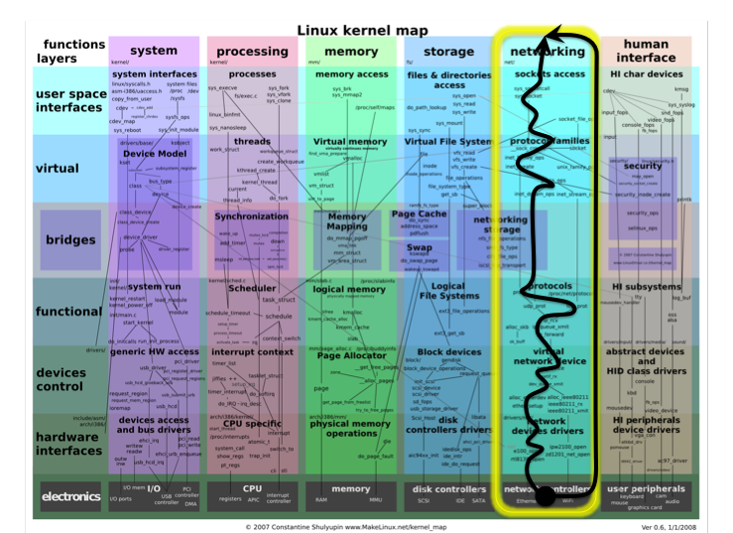

Slide 4
pointer chasing
At scale (millions of connects) nothing is in high-speed cache
Packet-descriptors -> TCB -> socket -> thread

Slide 5
layers
Layer1 – Physical
Bits onto the wire
Layer 2 – Local link
Frames to the next hop (local address)
Layer 3 – Internet
Packets across the net to the remote machine
Layer 4 – Transport
Payload to the target app

Slide 6
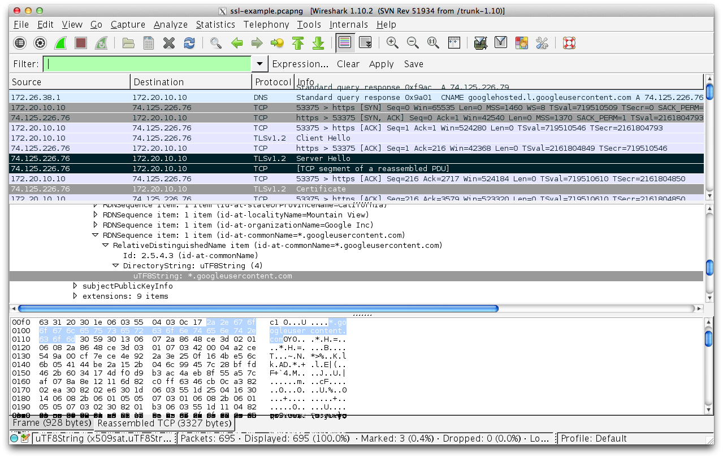
d

Slide 7
“block” parsers
Cast “struct ip_hdr” over bytes
Backtracking

Slide 8
“streaming” processors
Byte at a time

Slide 9

Parsing the bytes
If you are using ntohs(),
you are doing it wrong
short port = ntohs(*(short*)p);
int port = p[0]<<8 | p[1];
Notes:
One of the bad things Stevens taught students is to think about network bytes abstractly. The consequence is a generation of students who still can’t figure out byte-order/endianess correctly.
What you should have learned is this: the internal format of bytes is abstract, the external format is concrete, and NEVER mix the two.
Consider the ntohs() function that swaps bytes from the big-endian format in TCP/IP protocols to the little-endian format on x86 processors. It’s wrong. The reason it’s wrong is because it requires a cast to convert the external bytes into an integer before the byte swap. There are many problems with this, the worst being is that if the bytes are unaligned on RISC processors, the program crashes. A lot of software has never worked right on SPARC systems because it would occasionally mysterious crash in the field because programmers forget about this alignment problem.
The correct way of extracting an integer from a packet is one byte at a time, as shown in the slide. There’s two lessons here. The first is that internal formats are abstract. You don’t care about the format of the number. Just because it’s a two byte number doesn’t mean you need to use a short in to store it. The second lesson is that the external format is concrete. This expression extracts a two byte big-endian number, regardless of the internal byte order.
What’s interesting about this example is that it works in C# and Java, languages that don’t allow you to case integers over packets. That these languages forbid casting should be a good indication that you shouldn’t cast this stuff in C, either.

Slide 10
parser state machine
GET /index.html HTTP/1.0
Host: www.example.com
START
method
URI
version
space
space1
space2
space3
\n
colon
other
EOL
END
name
colon
value
Notes:
[THIS PAGE IS HEAVY ON ANIMALTION. RUN THE ANIMATION TO FIGURE OUT WHAT THE SPEAKER NOTES ARE TALKING ABOUT]
This slide takes byte parsing to the next level. What you see here is a state-machine representing the HTTP protocol. Each byte is read from the TCP stream one at a time, then fed to the state machine. What happens is that each byte causes a transition.
The first field of a HTTP is called the METHOD, and contains things like GET or POST. Here’s how we parse the method in the state machine:
If the character is space, we transition to the next field, which is the space between the method and URI. This is represented by a green line in the state machine.
If the character is a newline, we transition to the end-of-line. This is represented by a read line in the state machine.
If the character is anything else, we stay in the METHOD state.
We continue the same logic in the next state called SPACE1. As long as the character is a space, we stay in this state. On the first non-space character, we transition to the URI (or end-of-line) state.
What’s interesting about a state-machine is that we don’t care how many spaces there are in the SPACE1 field. As long as the next character is a space, it’ll stay in that state. In other words, consider the hypothetical example of a web server that uses a state-machine. It means you can send a request of a GET, followed by 5 billion spaces, followed by the rest of a normal HTTP header. Would this work? The answer is yes. That’s how Microsoft’s IIS web server works. I’ve done this test. At least, I did 10 years ago back when the software was 32-bit and it couldn’t buffer 5-gigabytes of data even if it wanted to.
The little red boxes on this slide are because I’ve created an animation showing the byte-by-byte parsing. I’m going to run this animation twice. First, notice on the left side how the HTTP header is parsed a byte at a time. The animation sucks and the box doesn’t line up on the characters, but you get the idea. Second, notice how each byte causes a transition in the state machine. I’m going to run it twice, just so you see how it works.

Slide 11
void http_parse(int *state, unsigned char c, ...)
{
switch (*state) {
case START: ...
case METHOD: ...
case URI: ...
case VERSION: ...
case VALUE: ...
case NAME: ...
case COLON: ...
case SPACE1: ...
case SPACE2: ...
case SPACE3: ...
case EOL: ...
}
}
Notes:
This slide shows how we would start implementing this state function in C.
We start with a function called “http_parse” that takes two key arguments, an integer containing the current “state” and the next “character” pulled from the TCP stream.
Note that this function doesn’t care whether the hacker is fragmenting an attack across multiple packets, or whether all the bytes are in a single packet.
The body of the function is structured to have a big switch/case statement, with one case per state in our state-machines. If you’ll notice, the names in this slide are identical to the names of the states in the diagram of the previous slide.

Slide 12
void http_parse(int *state, unsigned char c, ...)
{
switch (*state) {
...
case METHOD: /*GET, POST, HEAD, ...*/
if (c == '\n') {
*state = EOL;
} else if (strchr(WHITESPACE, c)) {
*state = SPACE1;
} else {
; /*no transition*/
}
...
}
}
Notes:
This slide shows how we code up a state transition. In this case, we choose the METHOD function.
This follows the same thing I described above. A newline transitions to the endofline state. Whitespace transitions to the SPACE1 state. Otherwise, we state in this state.

Slide 13
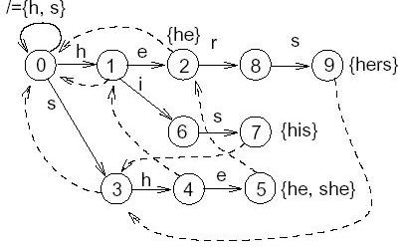
alert tcp any any -> any 80 (content:"GET"; http_method;)
Notes:
By the way, this state machine works a lot like other statemachines you see in networking.
For example, Snort uses the Aho-Corasick algorithm for pattern-matching. The way Aho-Corasick works is by combining thousands of patterns into a state diagram. To search for a pattern, Snort feeds a byte at a time to the Aho-Corasick engine, which causes an internal state transition.

Slide 14
void http_parse(int *state, unsigned char c,
int *ac, ...)
{
switch (*state) {
...
case METHOD:
if (c == '\n') {
search_end(xxMethods, ac);
*state = EOL;
} else if (strchr(WHITESPACE, c)) {
search_end(xxMethods, ac);
*state = SPACE1;
search_start(xxSpaces, ac, c);
} else {
search_continue(xxMethods, ac, c);
if (length++ > 128) …;
}
...
}
}
Notes:
So now that we’ve built a state-machine parser with HTTP, let’s build an IDS from it by adding Aho-Corasick.
That means we’ll need two state variables: one for the HTTP state, and one for the Aho-Corasick pattern matching state.
Before we run the parser, we compile all the strings we are looking for in the method field, like GET, PUT, GNUTELLA, and so on. We put them in a global variable we’ll call xxMethods. Then, for each byte in the method, we just feed it to the Aho-Corasick engine. If a pattern matches, that search function will call a call back or something.
Now let’s look at what happens when we transition from one field to the next. When we enter a new state, we have to re-initialize the Aho-Corasick state in the new table. This is showing in the code in the example of starting the next xxSpaces search. Likewise, just before leaving a state, we need to mark the fact that we are leaving, showing here were we end the xxMethods search.
Note that we can do other things than just pattern matching IDS. For example, we can trigger when the METHOD field exceeds a threshold in length and trigger a buffer-overflow event. Note that this ‘length’ value joins the HTTP parser state and Aho-Corasick state as yet another state variable, though I haven’t shown how in this code.

Slide 15
IDS and parser state machines
“Do you reassemble TCP?”
“Do you swap bytes?”
“Do you handle data normalization?”
Notes:
A common question about IDS is “do you reassemble TCP?”. In our hypothetical IDS above, the answer is “no but yes”. No, it doesn’t reassemble TCP, but that’s because it doesn’t have to. It simply remembers those state variables from one packet to the next without needing reassembly. It can pattern-match a method like “GNUTELLA”, even if that method string never appears whole in a single packet.
The answer “no but yes” is the same for “do you swap bytes”. The answer is no, but it gets the same result.
Likewise, consider Snort’s preprocessors for data normalization. A state-machine handles these natively, without needing to “normalize” it.
I present these questions to highlight what happens when you change the rules. These questions assume a certain underlying architecture and don’t apply when you completely change that architecture.

Slide 16
Properties
Low memory
We don’t buffer the HTTP method, we match the pattern as bytes arrive.
Don’t need to reassemble TCP
Robust
Can’t have a buffer overflow in code that doesn’t buffer things
All sorts of edge cases disappear
Gracefully “falls off the end” of a packet
Don’t need to free stuff
Notes:
Why use statemachines?
#1 is that the memory overhead is really small. It means that you can fit massive number of TCP connections in a tiny amount RAM. Consider Apache that allocates a 64k buffer for each request. That means 640-gigabytes for buffering for 10 million connections. But my example above with two state integers needs only 80 megabytes for 10 million connections
#2 is inherent robustness. You don’t have buffer overflows if you aren’t buffering anything. All sort of edge cases dispapear.
#3 scalability and performance. Programmers used to Stevens think it’s slow, but its very very fast.

Slide 17
Who does this?
Most everyone in closed-source
IDS: Proventia, Intruvert, Palo Alto
Web: IIS
… and so much more
Some open source
IDS: Snort, Suricata
ferret.googlecode.com
(this sucks BTW)
Notes:
I keep coming across this technique when reverse engineering. It’s widely used in the closed-source world. The reason is simple: if you want scalability, you have to do things this way.
There are also a few open source examples. They aren’t as common though. My Ferret tool has lots of weird examples, though the code sucks a lot. My nice looking code that does this is still closed source.

Slide 18
DFA Performance
state = table[state][c];
mov ebx[eax+ecx],%eax

Slide 19
One L1 cache hit per byte
mov ebx[eax+ecx],%eax mov ebx[eax+ecx],%eax mov ebx[eax+ecx],%eax mov ebx[eax+ecx],%eax mov ebx[eax+ecx],%eax
3 GHz CPU with 3 Hz cache – 8-gbps

Slide 20
switch/case
15 Hz branch misprediction
0 Hz branch prediction

Slide 21
Special case
Theory: byte-at-a-time
Practice: grab multiple bytes that are part of the same state

Slide 22
[http-parse]
https://github.com/robertdavidgraham/papers/blob/master/state-machine-perf/http-parse.c

Slide 23
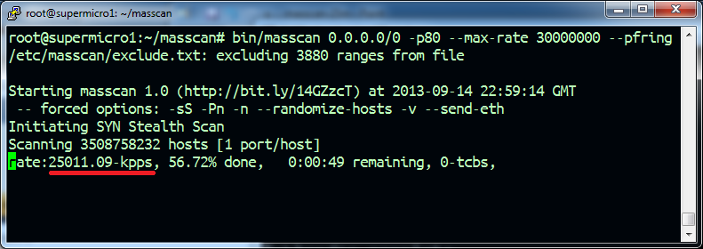
[masscan]
https://github.com/robertdavidgraham/masscan

Slide 24
SSL state machine parser:
https://github.com/robertdavidgraham/masscan/blob/master/src/proto-ssl.c
X.509 certificate parser:
https://github.com/robertdavidgraham/masscan/blob/master/src/proto-x509.c

